Slide 1
I’m not paying for HTTP.
Breaking out of closed source.
Notes:
I’m Pretty.

Slide 2
wtf?

Slide 3
Who am I?
Warren Fletcher
(Reformed) Web Scale Programmer ~ 10 years
Bsc. in Electrical Engineering.
Staff Systems Engineer at HYENA ~ 3 years

Slide 4
<Fluff Slide About Me>
Returned in 2023
<Silly photo of South Africa>

Slide 5
HYENA
Hydrogen Energy Applications
We make diesel-generator alternatives.
Cleaner, Quieter, Smarter.
Based in Muizenberg, Cape Town, South Africa

Slide 6
HYENA
<INSERT PHOTO OF HYENA STAFF>

Slide 7
HYENA
We convert the hydrogen in LPG to electricity via a fuel cell.

Slide 8
HYENA
We are a ‘hardtech’ spinout from UCT.
It hurts. It itches. It burns.

Slide 9
Industrial Automation
Computers controlling Hardware
Read Input -> Process -> Write Output
Everything is Async and Cyclical
Every cycle needs to start exactly ‘on time’

Slide 10
Industrial Automation
This is an entire industry (268 Billion USD 2025)
Started in the 1980s, and well, stayed there.
Think…. Huge Projects.

Slide 11
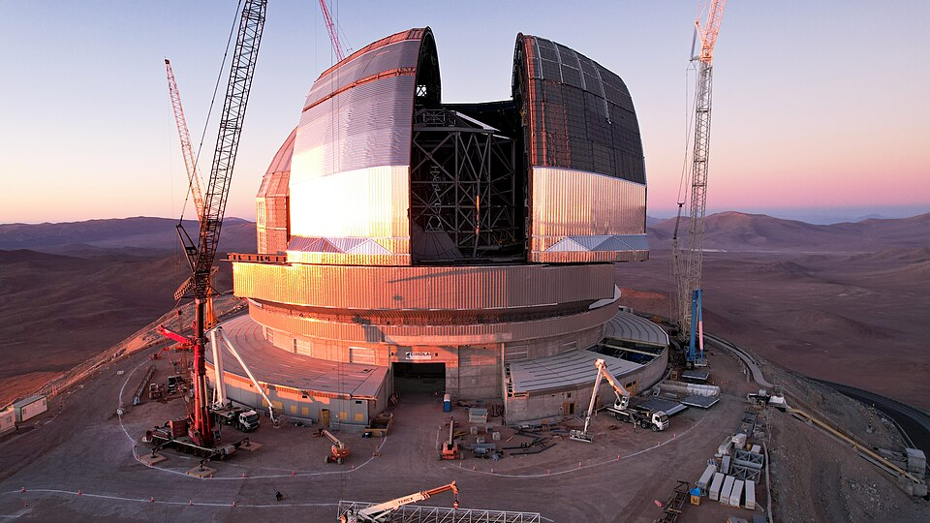
Like Telescopes

Slide 12
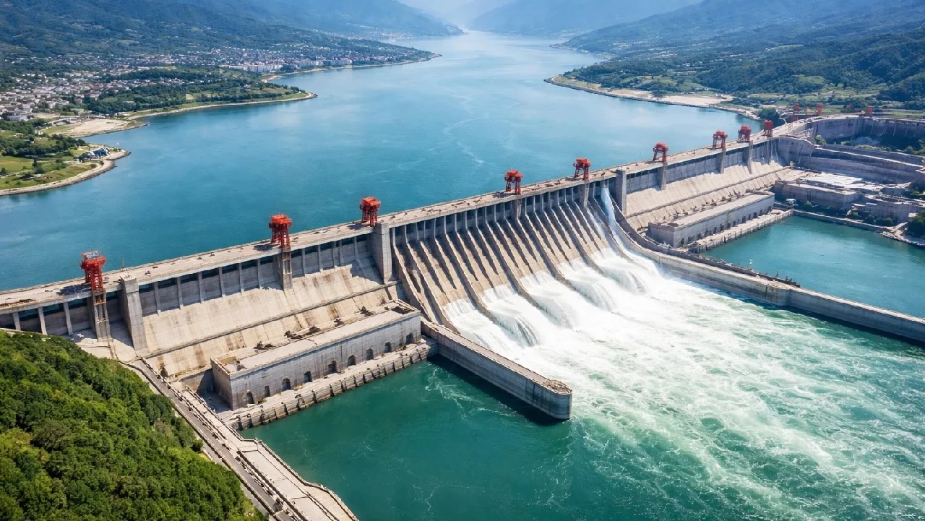
Like Dams

Slide 13
Like Generators
<INSERT PHOTO OF SEXY PROTOTYPE POWERPOD>

Slide 14





Hardware Vendors

Slide 15
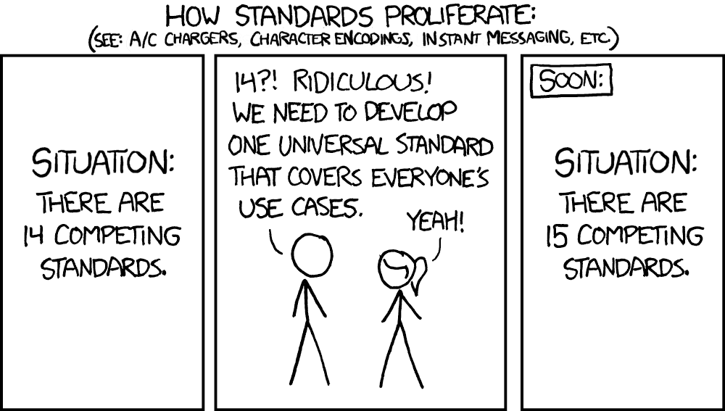
Variety!

Slide 16
Care to Share (Your source)?
No.
Fragmented Communities (By Vendor)

Slide 17
Disclaimer
I <3 our vendors.
This practice is pervasive.

Slide 18
The Good
Specialized ‘hardened’ technology.
Debugging on a PLC is amazing.

Slide 19
The Bad
Not your standard languages.
Everyone has their own take.
Support is limited
Who even learns this stuff?
Expensive.

Slide 20
The Ugly
Windows Only (This is changing!)
Technology develops extremely slowly

Slide 21
The Really Ugly
Black Box Development.
‘Error:Error’.
Perpetual BSOD Loop.
Libraries are vendor-specific, if even available.
Testing is cumbersome.
Did I mention expensive?

Slide 22
Put a price tag on this.

Slide 23
Why this is… ok (sort of)
Hardware is… hard. This stuff has material costs.
When a project is in the Millions of USD. What’s the problem?
Honestly, paid software comes with a lot of social expectations that tend to be enforced *

Slide 24
Insert Clippy telling you to fuck off.

Slide 25
Why this is… ok (sort of)
Hardware is… hard. This stuff has material costs.
When a project is in the Millions of USD. What’s the problem?
Honestly, paid software comes with a lot of social expectations that tend to be enforced *
*Microsoft excluded.

Slide 26
Licenses, Licenses, Licenses
... And this is where a line needs to be drawn.

Slide 27
Hotel California.
It’s comfy.
It’s convenient.
And the more time you spend here, the more it’s going to cost.
And a lot of these costs are hidden.

Slide 28
Walled Garden
This is why we have so little open-source.

Slide 29
What now?
I cannot, in good faith, continue.
But this is ‘the way it’s done’. Pay Up. Shut up.
* Insert German quote here.

Slide 30
We need a rewrite!
No you don’t*
You need to rewrite a part of this. But where?
*unless you’re windows 11

Slide 31
What do we rewrite?
We can’t put everything on commodity hardware.
We still need the Realtime control, But only for hardware IO

Slide 32
How to Justify this?
Use money. Managers speak that language.
CapEx cost per unit.
Reinventing (Many) wheels.
Skills Shortage.
Don’t block critical path.

Slide 33
Justification
We had a working, just very flimsy version.
Use this for hardware testing.
Skills Development.

Slide 34
Who is going to do this?
Us, of course.
Us, two juniors and a web-scale developer with zero experience

Slide 35
Hello Dunning-Kruger my old friend
I first estimated we could do this in about 3 months.
Our first working alternative took about 6… oops.

Slide 36
Picture of Dunning Kruger

